Slide 1
Operating Systems
Process Management
[Processes & Threads]

Slide 2
Process Definition
Process – a program in execution; execution progresses in sequential fashion.
A process is sometimes called a job or a task or a sequential process

Slide 3
Process Image… contd,
a Process Image is a snapshot of the state of a running program, including its code, data, and system resources.
When a program is executed, the operating system creates a process that represents the program and allocates resources such as memory, file handles, and CPU time to that process.
The process image is essentially a copy of the program's executable code, along with any shared libraries (it depends on), and the current state of its memory and registers. This snapshot can be used to restore the process to the same state at a later time.

Slide 4
The process image is typically created when a program is loaded into memory, and it is used by the operating system to manage the program's execution.
For example, when a program is paused or interrupted, the process image can be saved to disk so that it can be restored later. Similarly, when a program is migrated to another machine, the process image can be transmitted along with the program's code and data to ensure that the program continues to run correctly.

Slide 5
Process Image
More than just set of instructions
  Code section
  Data section
  Stack section

Slide 6
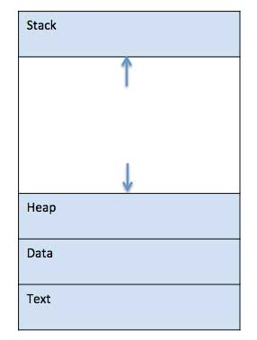
Process Image

Slide 7
Code Section
The program to be executed.
It contains the executable code of the program. This section is usually
read-only and contains the program instructions in machine language.
Also called as the Text section.

Slide 8
Data Section
The modifiable part of the user space. May include program data, a user stack area, and programs that may be modified.
It contains the program's initialized global and static variables. This section is typically read-write and contains data that is initialized to a specific value.
Also known as Initialized data section.

Slide 9
Stack Section
Each process has one or more LIFO system stacks associated with it.
The stack section contains the program's runtime stack that is used to store parameters and calling addresses for system calls.
This section grows dynamically as functions are called and returns are made.

Slide 10
Other Sections
In addition to these three main parts, the process image may also include additional sections such as:
    Heap section
    Uninitialized data section
    Operating system resources

Slide 11
Other Sections
  Heap section: The heap section contains dynamically allocated memory, which is managed by the program using functions such as malloc() and free().
  Uninitialized data section: The uninitialized data section, contains global and static variables that are uninitialized or initialized to zero.
  Operating system resources: The process image also includes operating system resources such as open file descriptors, network connections, and other system resources that the program has acquired.

Slide 12
Types of Processes
I/O bound Process
CPU bound Process

Slide 13
Process States
As a process executes, it changes state
  new: The process is being created.
  running: Instructions are being executed.
  waiting: The process is waiting for some event to occur.
  ready: The process is waiting to be assigned to a processor.
  terminated: The process has finished execution.

Slide 14

Diagram of Process State

Slide 15
Process Control Block (PCB)
The process control block is a data structure used by the operating system to store information about a process. It contains information such as the process ID, program counter, CPU registers, memory allocation, and other important information needed by the operating system to manage the process.
It is created and maintained by the operating system, and it is stored in memory separate from the process image. The process control block is typically used by the operating system to keep track of each process and to switch between processes as needed.
Notes:
Information associated with each process.

Slide 16
Process Control Block (PCB)
Process state
Program counter
CPU registers
CPU scheduling information
Memory-management information
Accounting information
I/O status information
Notes:
Information associated with each process.

Slide 17

Process Control Block (PCB)

Slide 18
Process
An address space + at least one thread of execution
  Address space offers protection among processes
  Threads offer concurrency
A fundamental unit of computation

Slide 19
Process =? Program
Program: a collection of statements in C or any programming languages
Process: a running instance of the program, with additional states and system resources

Slide 20
Process >? Program
Two processes can run the same program
  The code segment of two processes are the same program

Slide 21
Program >? Process
A program can create multiple processes
  Example: gcc, netscape

Slide 22
Analogy
Program: a recipe
Process: everything needed to cook
  e.g., kitchen
Two chefs can cook the same recipe in different kitchens
One complex recipe can involve several chefs

Slide 23
Trace of the Process
Sequence of instruction that execute for a process
Dispatcher switches the processor from one process to another

Slide 24
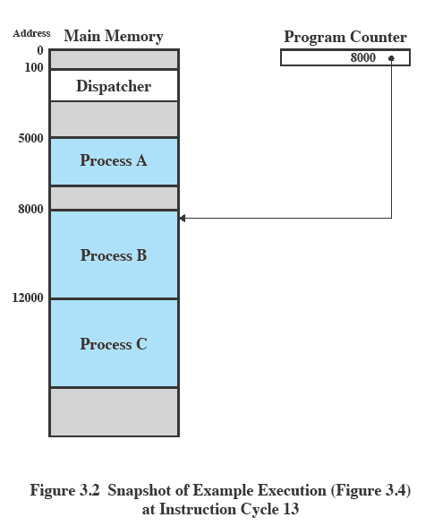
Example Execution

Slide 25
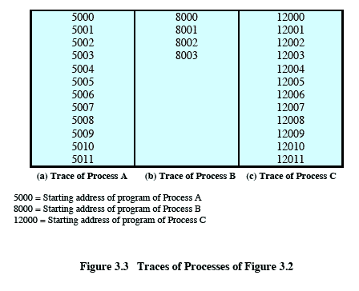
Trace of a Process

Slide 26
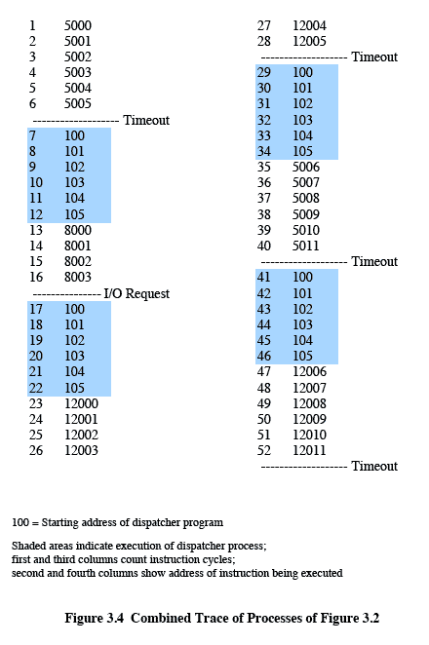
Combined Trace of Process

Slide 27
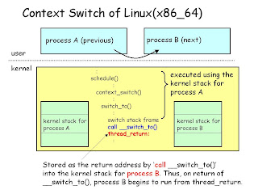
Context Switch
(sometimes called process switch)
A context switch involves two processes:
  One leaves the Running state
  Another enters the Running state
The status (context) of 1st process is saved; the status of the 2nd process restored.
Don’t confuse with Mode
switch.

Slide 28
Context Switch
Context-switch time is overhead; the system does no useful work while switching.
Time dependent on hardware support.

Slide 29

CPU Switch From Process to Process

Slide 30
Diagram of Process State

Slide 31
Process Scheduling Queues
Job queue – set of all processes in the system.
Ready queue – set of all processes residing in main memory, ready and waiting to execute.
Device queues – set of processes waiting for an I/O device.
The process migrates between these various queues.

Slide 32
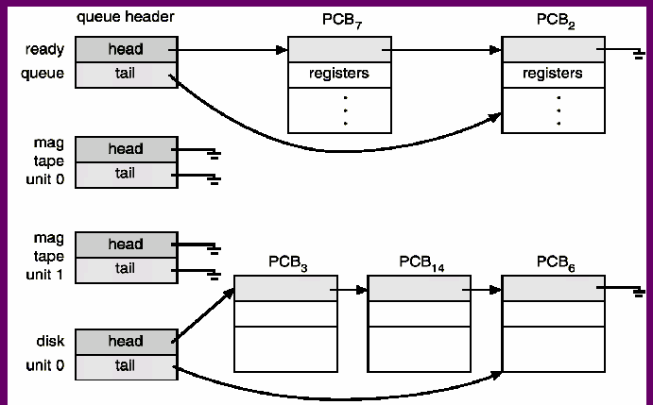
Ready Queue And Various I/O Device Queues

Slide 33

Representation of Process Scheduling

Slide 34
Schedulers
Long-term scheduler
Short-term scheduler
Medium term Scheduler

Slide 35
Long Term Scheduler
(or Job Scheduler) – selects which processes should be brought into the Ready Queue.
Long-term scheduler is invoked very infrequently (seconds, minutes) ⇒ (may be slow).
The long-term scheduler controls the degree of multiprogramming.

Slide 36
Diagram of Process State

Slide 37
Short Term Scheduler (or CPU Scheduler)
Also called the Dispatcher.
(milliseconds) ⇒ (must be fast).
It selects which process should be executed next and allocates this process the CPU. It is invoked very frequently. These are the reasons:
Time Slice finishes
Termination of a process
Need to wait for an Event (process goes to a Wait State)
Interrupt
Trap (?)
Signal (Reading Homework)

Slide 38
Medium Term Scheduler
Swapper
  Swaps the Processes btw memory space
Factors Invoking Medium Term Scheduler
  High Priority Process
  Memory Request

Slide 39

Medium Term Scheduling (Figure)

Slide 40
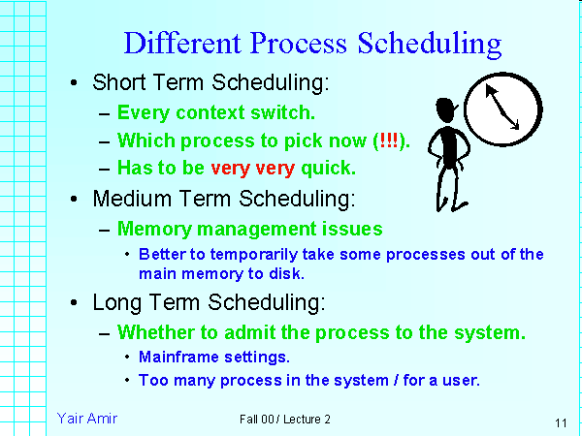

Slide 41
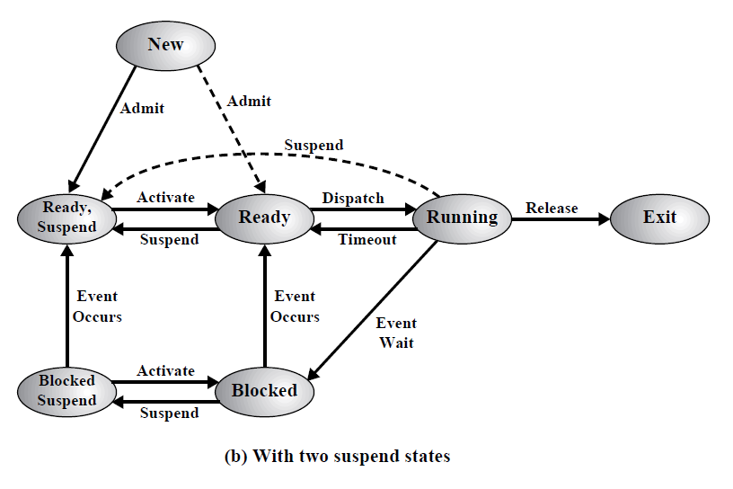

Slide 42
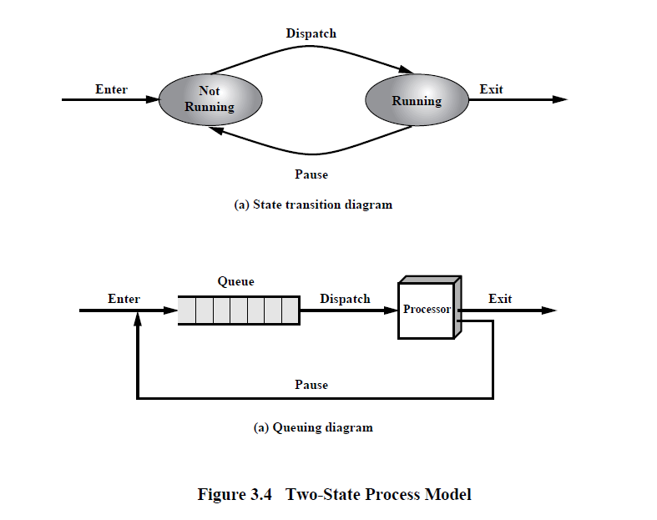

Slide 43
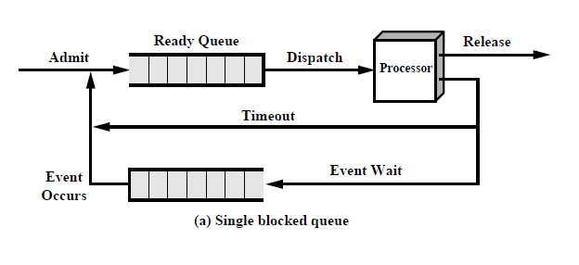

Slide 44
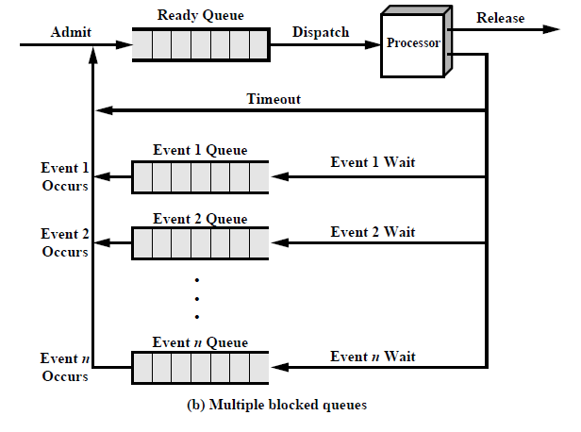

Slide 45
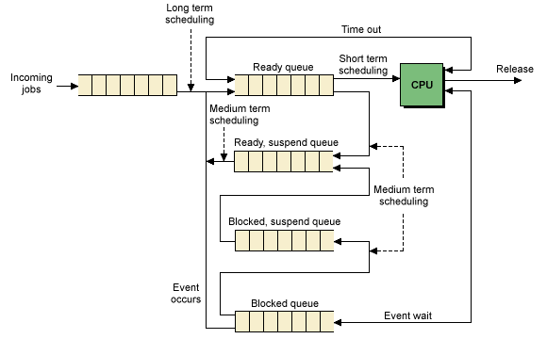
Role of Different Schedulers…

Slide 46
Suspended Processes
Processor is faster than I/O so all processes could be waiting for I/O
Swap these processes to disk to free up more memory
Blocked state becomes suspend state when swapped to disk
Two new states
  Blocked/Suspend
  Ready/Suspend

Slide 47
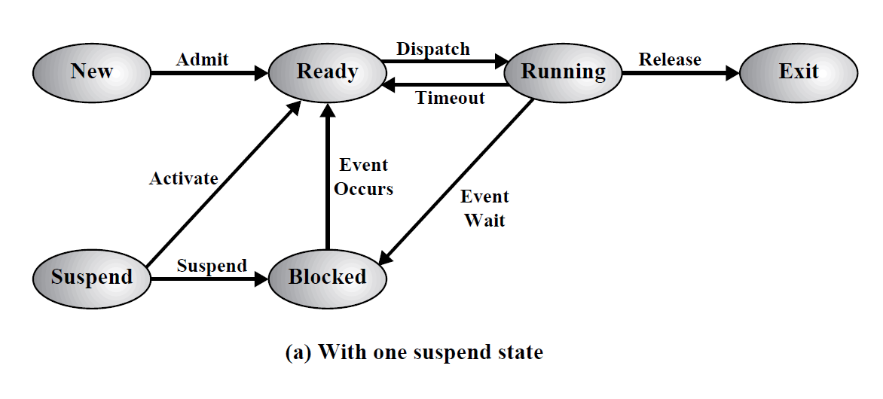

One Suspend State

Slide 48
Two Suspend States

Slide 49
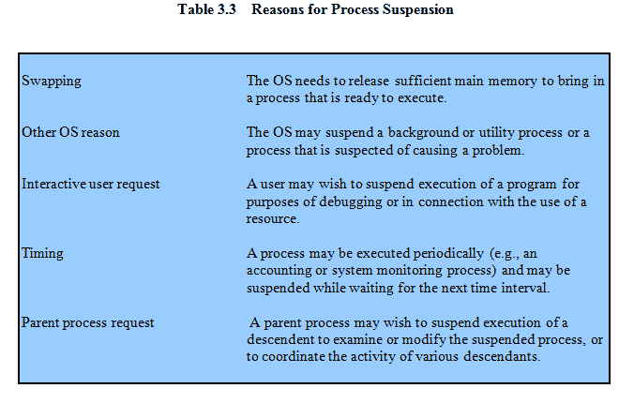
Reasons for Process Suspension

Slide 50

New Transitions Explained
Blocked → Blocked,suspend:
This can happen in both situations as follows:
  When there are no Ready processes: then the OS swaps out at least one blocked process to make room for another process that is not blocked.
  When there are Ready processes available: if the OS determines that the currently running process (or a ready process that it would to dispatch) requires more main memory to maintain adequate performance

Slide 51
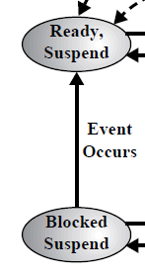
Blocked,suspend → Ready,suspend:
A process in the Blocked,suspend state is moved to the Ready,suspend state when the event for which it has been waiting occurs.

Slide 52

Ready,suspend → Ready: This can happen because of two reasons as follows:
  if there are no ready processes in the ready list (MM), the OS will need to bring one in to continue execution.
  A process in the Ready, suspend state has higher priority than any of the processes in the Ready state.

Slide 53
Ready → Ready,suspend: This transition seems odd since the OS would prefer to suspend a blocked process rather than a ready one, because the ready process can now be executed, whereas the blocked process is taking up MM space and cannot be executed??? Two reasons again:
Reason-1: It may be necessary to suspend a ready process if that is the only way to free a sufficiently large block of MM space.
Reason-2: The OS may choose to suspend a lower-priority ready process rather than a higher-priority blocked process if it believes that the blocked process will be ready soon.

Slide 54

Blocked,suspend → Blocked: This one seems VERY odd, because:
  if a process is not ready to execute, and
  If it is not already in the MM, what is the point of bringing it in???
Consider this scenario: A running process terminates, freeing some MM. There is a process in the (Blocked,suspend) queue with a higher priority than any of the processes in the (Ready,suspend) queue and the OS has some reason to believe that the blocking event for that process will occur soon.
Now, it seems reasonable to bring a blocked process into the MM in preference to a ready process.

Slide 55
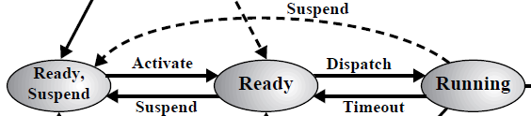
Running → Ready,suspend: Normally, a running process is moved to the Ready state when its time allocation expires. Then why this transition happens???
  Reason: If the OS is preempting the running process because a higher-priority process on the (Blocked,suspend) queue has just become unblocked, the OS could move the running process directly to the (Ready,suspend) queue and free some MM.

Slide 56
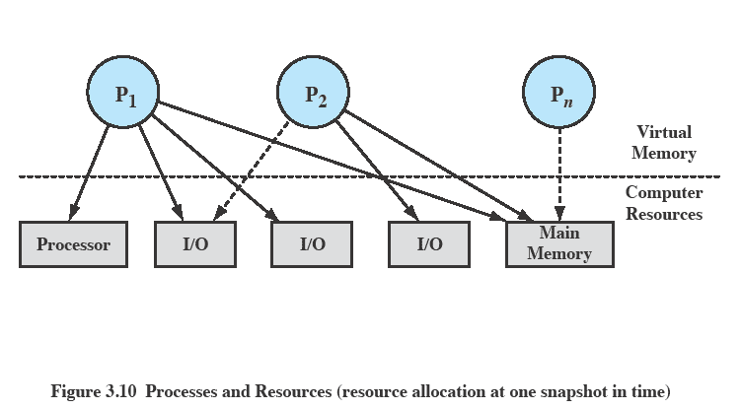
Processes and Resources

Slide 57
Operating System Control Structures
Information about the current status of each process and resource
Tables are constructed for each entity the operating system manages

Slide 58
Memory Tables
Allocation of main memory to processes
Allocation of secondary memory to processes
Protection attributes for access to shared memory regions
Information needed to manage virtual memory

Slide 59
I/O Tables
I/O device is available or assigned
Status of I/O operation
Location in main memory being used as the source or destination of the I/O transfer

Slide 60
File Tables
Existence of files
Location on secondary memory
Current Status
Attributes
Sometimes this information is maintained by a file management system

Slide 61
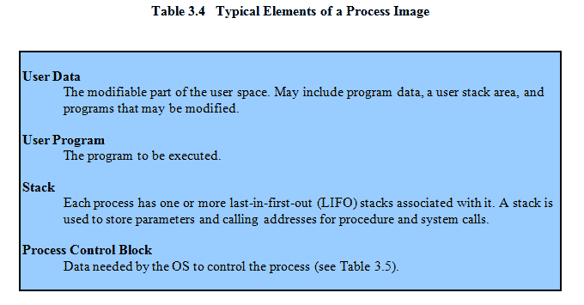
Process Tables
Manage processes
Process control block
  Process image is the collection of program. Data, stack, and attributes

Slide 62
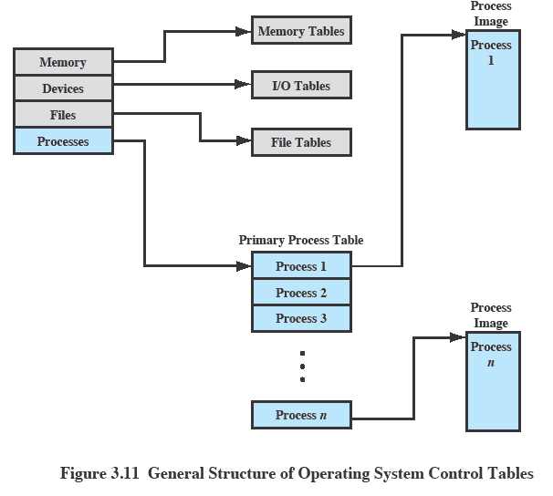
OS Control Tables

Slide 63
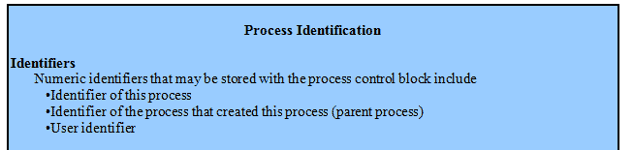
Elements of a Process Control Block

Slide 64
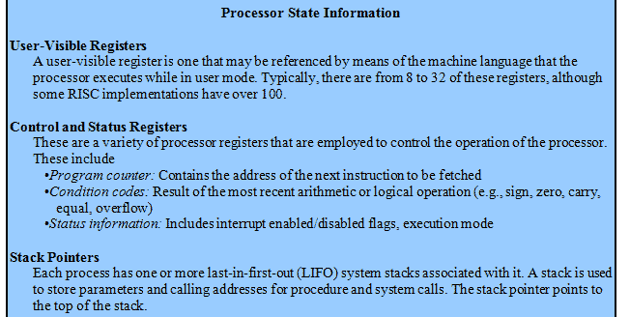
Elements of a Process Control Block

Slide 65
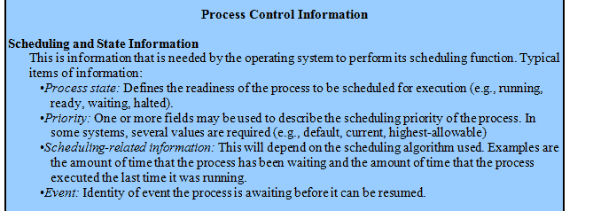
Elements of a Process Control Block

Slide 66
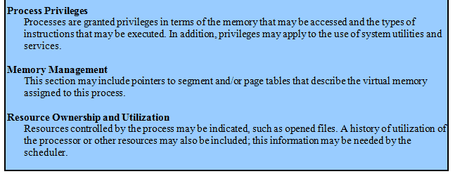
Elements of a Process Control Block

Slide 67

Process Creation
A process tree
  A created two child processes, B and C
  B created three child processes, D, E, and F

Slide 68
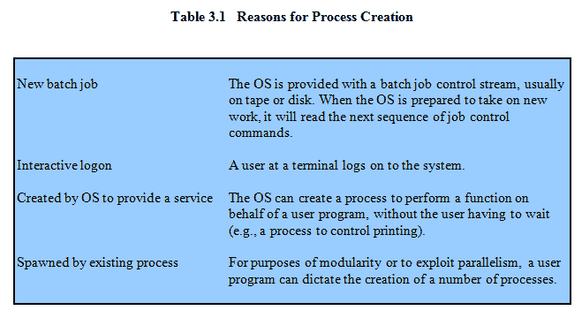
Process Creation

Slide 69
Process Creation
Parent process create children processes, which, in turn create other processes, forming a tree of processes.
Resource sharing
  Parent and children share all resources.
  Children share subset of parent’s resources.
  Parent and child share no resources.
Execution
  Parent and children execute concurrently.
  Parent waits until children terminate.

Slide 70
Process Creation (Contd.)
Address space
  Child duplicate of parent.
  Child has a program loaded into it.
UNIX examples
  Fork() system call creates new process
  Exec() system call used after a fork to replace the process’ memory space with a new program.

Slide 71
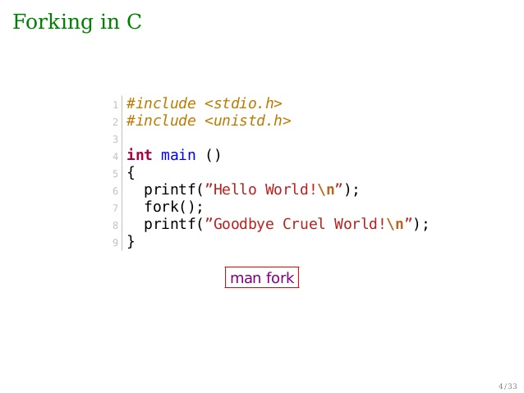
Forking in C-Language…

Slide 72
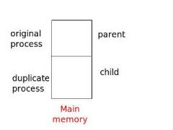
Parent-Child Forking (Memory Image)

Slide 73
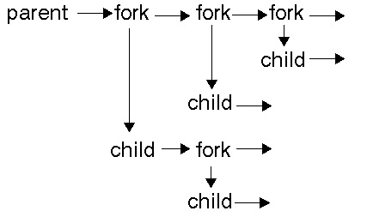
Parent-Child Forking

Slide 74
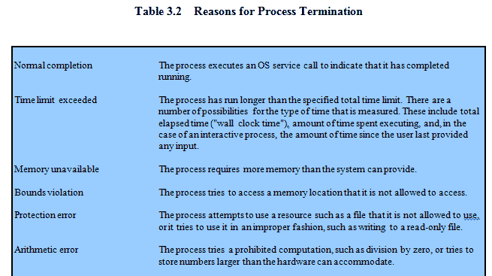
Process Termination

Slide 75
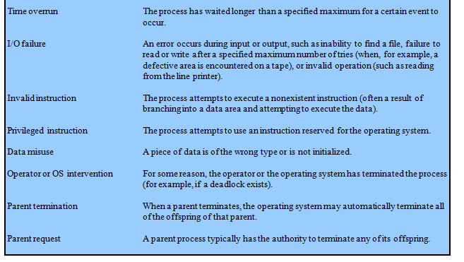
Process Termination

Slide 76
Process Termination
Process executes last statement and asks the operating system to decide it (exit).
  Output data from child to parent (via wait).
  Process’ resources are de-allocated by operating system.
Parent may terminate execution of children processes (abort).
  Child has exceeded allocated resources.
  Task assigned to child is no longer required.
  Parent is exiting.
    Operating system does not allow child to continue if its parent terminates.
    Cascading termination.

Slide 77
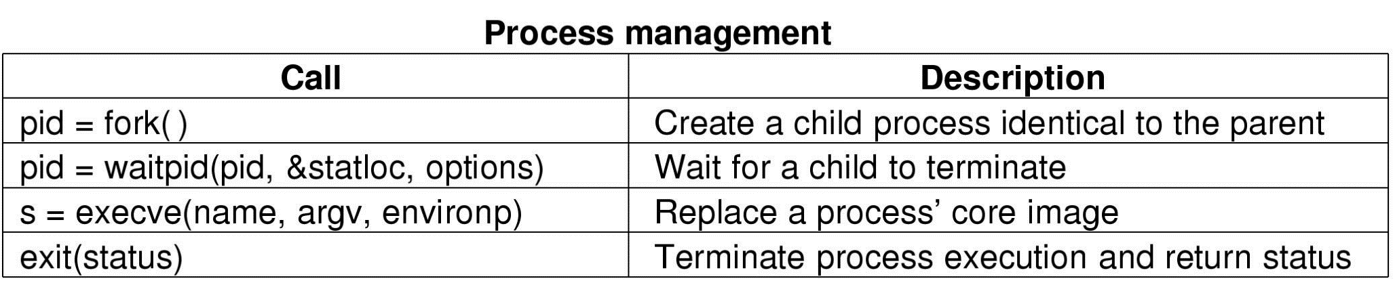
Some System Calls For Process Management

Slide 78
Zombie Process?
If a child process finishes execution (i.e. terminates) but its parent has not yet called wait() system call to collect its exit status, then the child remains in the process table as a Zombie process.
  It’s “dead” (finished) but still has an entry in the process table.
  The OS keeps that entry until the parent reads the child’s exit status.

Slide 79
Wait() System Call behavior – (No Zombie here / No Orphan Process here)
#include <stdio.h>
#include <unistd.h>
#include <sys/wait.h>
int main() {
pid_t pid = fork(); // Create a child process
if (pid == 0) {
// Child process
printf("Child: I am finishing my work now.\n");
} else {
// Parent process
wait(NULL); // Waits for the child to finish
printf("Parent: I collected my child's status.\n");
}
return 0;
}

Slide 80
Wait() System Call behavior - Zombie here
#include <stdio.h>
#include <unistd.h>
int main() {
pid_t pid = fork(); // Create a child process
if (pid == 0) {
// Child process
printf("Child: I am done now.\n");
} else {
// Parent process
printf("Parent: I'm not waiting for my child yet!\n");
sleep(10); // Parent sleeps instead of calling wait()
printf("Parent: Now I'm finishing.\n");
}
return 0;
}

Slide 81
Orphan Process?
if the parent process terminates first while the child is still running, then the child becomes an Orphan Process — and it gets adopted by the init process.

Slide 82
Wait() System Call behavior - Orphan here
#include <stdio.h>
#include <unistd.h>
int main() {
pid_t pid = fork();
if (pid > 0) {
// Parent process
printf("Parent: I'm finishing now.\n");
} else {
// Child process
sleep(10); // Child is still running after parent is gone
printf("Child: My parent is gone, so I'm now an orphan!\n");
}
return 0;
}

Slide 83
Threads
A sequential execution stream
  The smallest CPU scheduling unit
  Can be programmed as if it owns the entire CPU
    Implication: an infinite loop within a thread won’t halt the system
  Illusion of multiple CPUs on a single machine

Slide 84
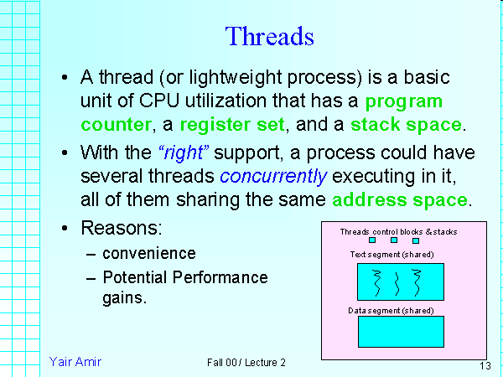

Slide 85
Thread Benefits
By splitting the work into smaller tasks and running them in parallel, threads can improve performance and responsiveness of the application.

Slide 86
Thread States
Program counter
Register Set (containing values)
Execution stacks

Slide 87
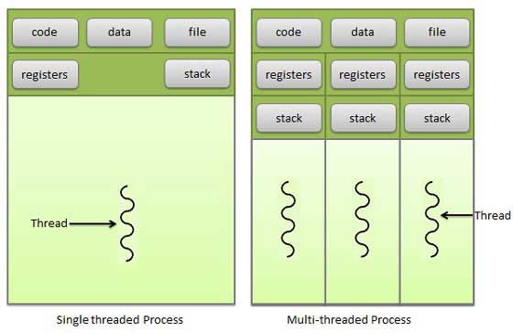
Single/Multithreaded Models

Slide 88
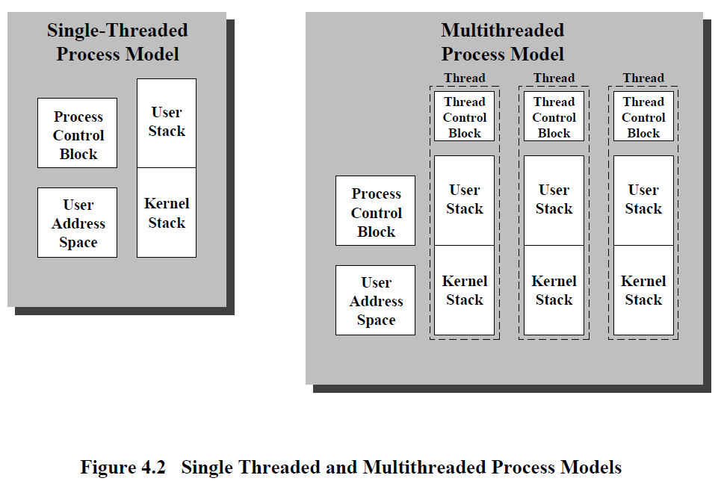
Single/Multithreaded Models

Slide 89
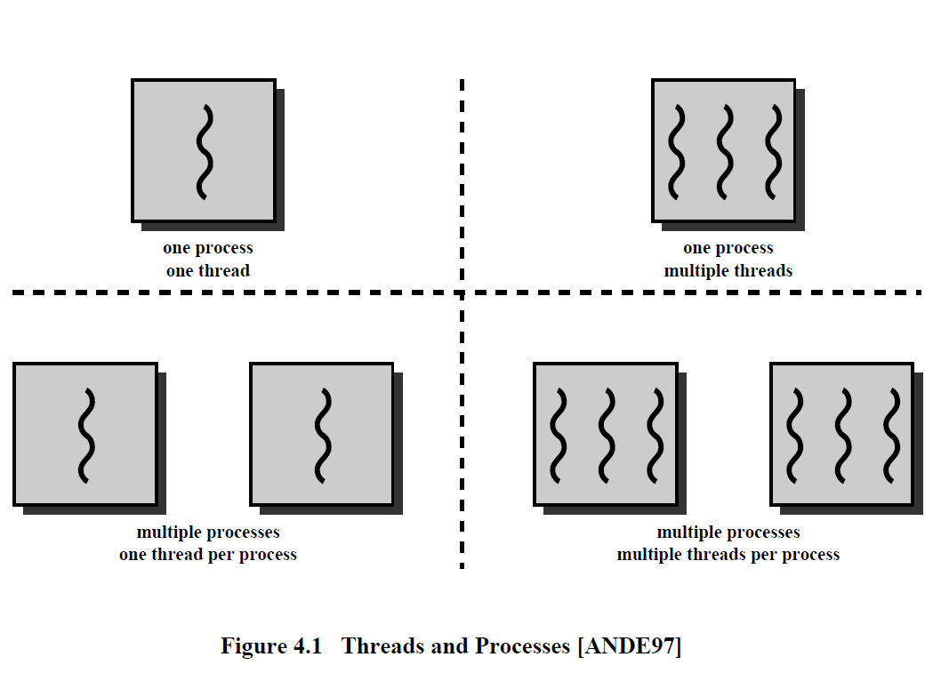
Threads Models

Slide 90
Classifications of OS’s
 | Single address space | Multiple address spaces
Single thread | MS DOS, Macintosh | Traditional UNIX
Multiple threads | Embedded systems | Windows NT, Solaris, OS/2

Slide 91
Thread Benefits
Simplified programming model per thread
Example: Microsoft Word
  One thread for grammar check; one thread for spelling check; one thread for formatting; and so on…
  Can be programmed independently
  Simplifies the development of large applications

Slide 92
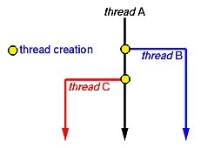
Thread Creation

Slide 93
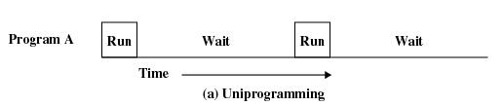
Uniprogramming
Processor must wait for I/O instruction to complete before preceding

Slide 94
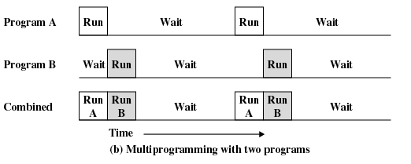
Multiprogramming
When one job needs to wait for I/O, the processor can switch to the other job

Slide 95
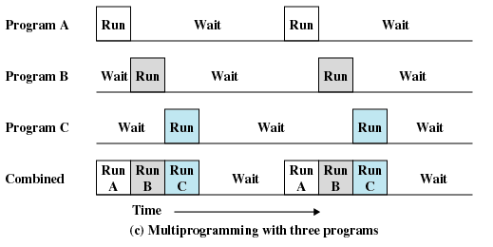
Multiprogramming

Slide 96
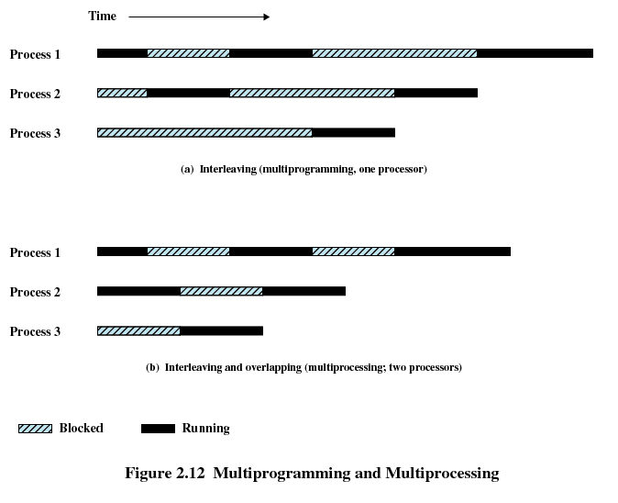
Multiprogramming and Multiprocessing

Slide 97
Threads & Dispatching Loop
A thread owns a thread control block
  Execution states of the thread
  The status of the thread
    Running or sleeping
  Scheduling information of the thread
    e.g., priority

Slide 98
Dispatching Loop
Threads are run from a dispatching loop
  LOOP
    Run thread
    Save states
    Choose a new thread to run
    Load states from a different thread
Jump to the first instruction
Context
switch
Scheduling

Slide 99
Simple? Not Quite…
How does the dispatcher regain control after a thread starts running?
What states should a thread save?
How does the dispatcher choose the next thread?

Slide 100
How Does the Dispatcher Regain Control?
Two ways:
  Internal events (“Sleeping Beauty”)
    A thread is waiting for I/O
    A thread is waiting for some other thread
    Yield—a thread gives up CPU voluntarily
  External events
    Interrupts—a complete disk request
    Timer—it’s like an alarm clock

Slide 101
What States Should a Thread Save?
Anything that the next thread may trash before a context switch
  Program counter
  Registers
  Changes in execution stack

Slide 102
How Does the Dispatcher Choose the Next Thread?
The dispatcher keeps a list of threads that are ready to run
If no threads are ready
  Dispatcher just loops
If one thread is ready
  Easy

Slide 103
How Does the Dispatcher Choose the Next Thread?
If more than one thread are ready
  We choose the next thread based on the scheduling policies
  Examples
    FIFO (first in, first out)
    LIFO (last in, first out)
    Priority-based policies

Slide 104
How Does the Dispatcher Choose the Next Thread?
Additional control by the dispatcher on how to share the CPU
  Examples:
Run to completion
A
B
C
Time
Timeshare the CPU
A
B
C
A
B
C
A
C
A
C
Time

Slide 105
Per-Thread States
Each thread can be in one of the three states
  Running: has the CPU
  Blocked: waiting for I/O or another thread
  Ready to run: on the ready list, waiting for the CPU

Slide 106
Per-Thread State Diagram
Running
Scheduled
I/O request
Yield, timer
Ready
Blocked
I/O complete

Slide 107
Thread Creation
Use pthread_create() instead of fork()
A newly created thread will share the address space of the current process and all resources (e.g., open files)
+ Efficient sharing of states
- Potential corruptions by a misbehaving thread

Slide 108
Thread Creation
A simple C program that demonstrates the usage of pthread_create() to create a new thread under the Linux environment:
#include <stdio.h>
#include <stdlib.h>
#include <pthread.h>
// Function executed by the new thread
void *thread_function(void *arg) {
printf("This is the new thread.\n");
printf("Argument passed to the thread: %s\n", (char *)arg);
pthread_exit(NULL);
}
int main() {
pthread_t tid; // Thread ID
char *message = "Hello from the main thread!"; // Message to pass to the new thread
// Create a new thread
if (pthread_create(&tid, NULL, thread_function, (void *)message) != 0) {
fprintf(stderr, "Error creating thread.\n");
return 1;
}

Slide 109
Thread Creation
printf("This is the main thread.\n");
// Wait for the new thread to finish
if (pthread_join(tid, NULL) != 0) {
fprintf(stderr, "Error joining thread.\n");
return 1;
}
printf("Main thread exiting.\n");
return 0;
}
```
This program creates a new thread using pthread_create() and passes a message to it. The main thread then continues its execution, while the new thread executes the function `thread_function()`. Finally, the main thread waits for the new thread to finish using pthread_join().

